Slide 1

Platform
SkyPilot on EKS
Architectural Report
Focus
High-Performance Compute-as-a-Service Architecture
Researcher Experience (RX)
Date
December 2025
SkyPilot on EKS: Technology Stack for Maximum Researcher Experience

Slide 2

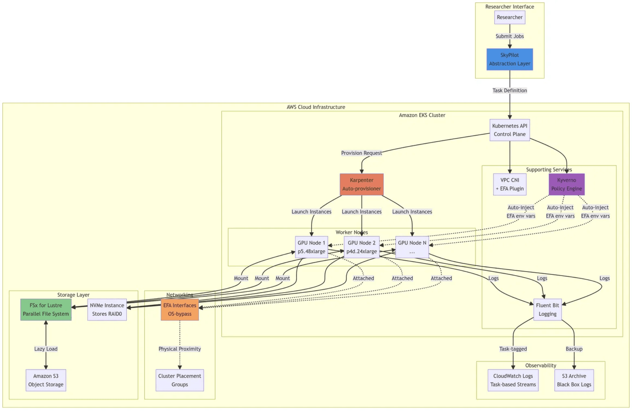
The Challenge: Bridging the Abstraction Gap
Standard Kubernetes Patterns vs. Deep Learning Workloads
General-purpose Kubernetes prioritizes resilience over the raw throughput required for HPC.
System Architecture Overview
Networking:
❑
TCP is insufficient for LLM training synchronization (NCCL).
Storage:
❑
Standard EBS volumes starve expensive GPUs of data.
❑
Startup:
Default image pulls cause 5-10 minute delays.
Observability:
❑
Generic logging obscures job history across retries.
Researcher Experience (RX)
"Minimization of infrastructure friction—latency in job startup, complexity in data access, and opacity in failure recovery—while maximizing computational throughput."
High-Performance Compute-as-a-Service
Slide 2

Slide 3

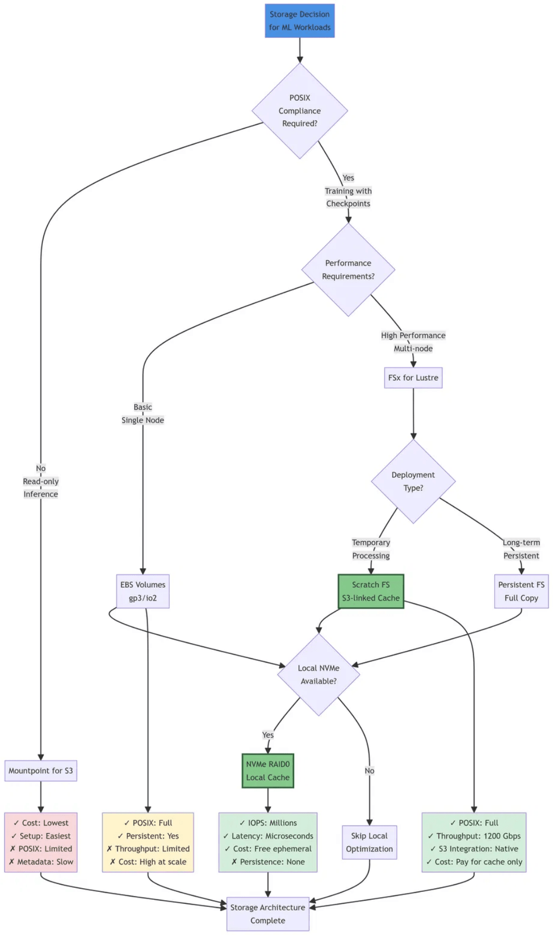
Storage Architecture: The Storage Trilemma
Balancing POSIX Compliance, Throughput, and Cost
Mountpoint for S3
Decision Logic Tree
Cost-effective but lacks full POSIX support. Slow metadata operations.
The "Easy Way"
FSx for Lustre
Full POSIX, 1200 Gbps throughput, native S3 integration.
The "High-Performance Way"
NVMe Instance Stores
Ephemeral, microsecond latency. Requires boot-time formatting.
Local Caching Layer
Key Decision
FSx for Lustre Scratch + Automated NVMe RAID0
High-Performance Compute-as-a-Service
Slide 3

Slide 4

Storage Data Flow: From S3 to GPU
FSx Lazy-Loading with NVMe Caching Eliminates I/O Bottlenecks
Data Flow Architecture
Stage 01
Stage 02
Stage 03
Initial Access
Active Training
Checkpoint Persistence
FSx lazy-loads data from S3 on first access. Metadata servers coordinate parallel I/O streams via EFA, achieving 1200 Gbps throughput.
Pods mount FSx as standard POSIX filesystem. Hot data sits in RAM page cache; overflow goes to local NVMe RAID0 scratch space.
MOUNT_CACHED mode writes checkpoints to local NVMe at GB/s, then asynchronously uploads to S3, unblocking the GPU.
High-Performance Compute-as-a-Service
Slide 4

Slide 5


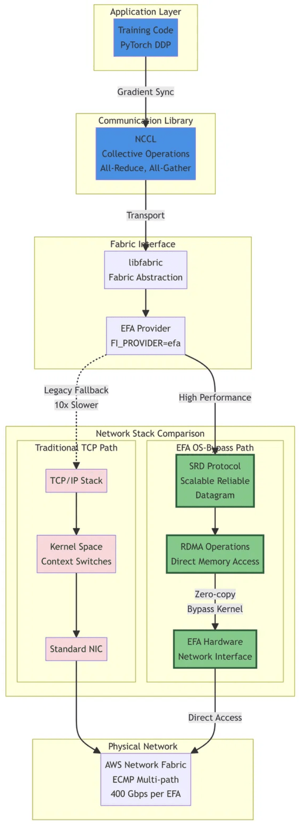

High-Performance Networking
EFA and OS-Bypass: Reducing Latency by 10x
SRD Protocol
Network Stack Comparison
Scalable Reliable Datagram (SRD) sprays packets across all network paths (ECMP) to utilize full bandwidth, unlike TCP's single path.
OS-Bypass
Bypasses the kernel TCP/IP stack. Enables zero-copy data transfer directly from GPU memory to the network interface.
400 Gbps
Throughput Per Interface
High-Performance Compute-as-a-Service
Slide 5

Slide 6

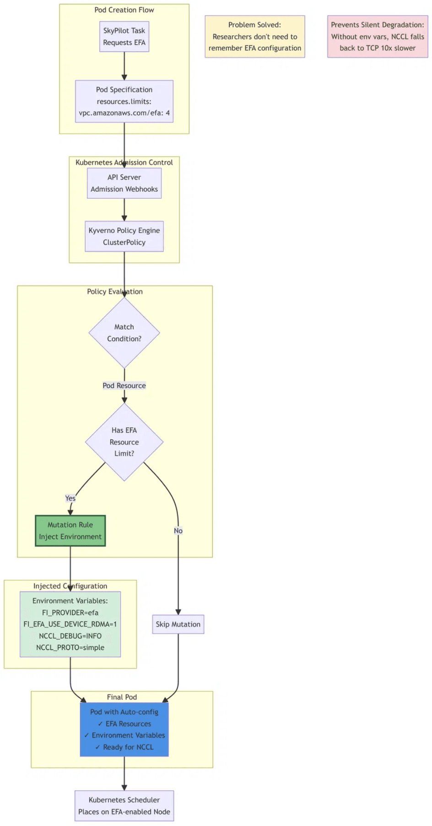
Automated Configuration: Kyverno Policy Engine
Preventing Silent Performance Degradation via Policy-as-Code
The Silent Failure
Admission Control Flow
Without specific environment variables, NCCL silently falls back to TCP, running 10x slower than EFA.
Auto-Injection Logic
Kyverno detects pods requesting vpc.amazonaws.com/efa and injects:
FI_PROVIDER=efa FI_EFA_USE_DEVICE_RDMA=1 NCCL_DEBUG=INFO NCCL_PROTO=simple
High-Performance Compute-as-a-Service
Slide 6

Slide 7

Cluster Placement Groups
Minimizing Physical Latency for Distributed Training
Network Latency
Physical Topology & Configuration
10-20 μs
Within Placement Group (vs. 100-500 μs scattered)
GPU Utilization
90%
Effective Compute Time (vs. 60-70% without CPG)
The Karpenter Workaround
Karpenter lacks native dynamic placement group support. Solution: Use pre-provisioned groups referenced via Launch Templates in the EC2NodeClass.
High-Performance Compute-as-a-Service
Slide 7

Slide 8

Observability: User-Centric Logging
Bridging the Gap Between Scheduler Task IDs and Kubernetes Pod UIDs
The Observability Chasm
Log Rewrite Pipeline
Researchers think in "Tasks" (sky-job-123). Kubernetes thinks in "Pods" (pod-abcde).
Default logging scatters job history across multiple pod streams, making debugging retries nearly impossible.
Fluent Bit Solution

Label Injection:
SkyPilot tags pods with Task IDs.
Rewrite Tag:

Fluent Bit extracts ID to create new routing tags.
Dynamic Streams:

CloudWatch streams named by Task ID.
Spot Reliability: Node Termination Handler triggers "Last Gasp" log flush to S3 before instance reclamation.
High-Performance Compute-as-a-Service
Slide 8

Slide 9

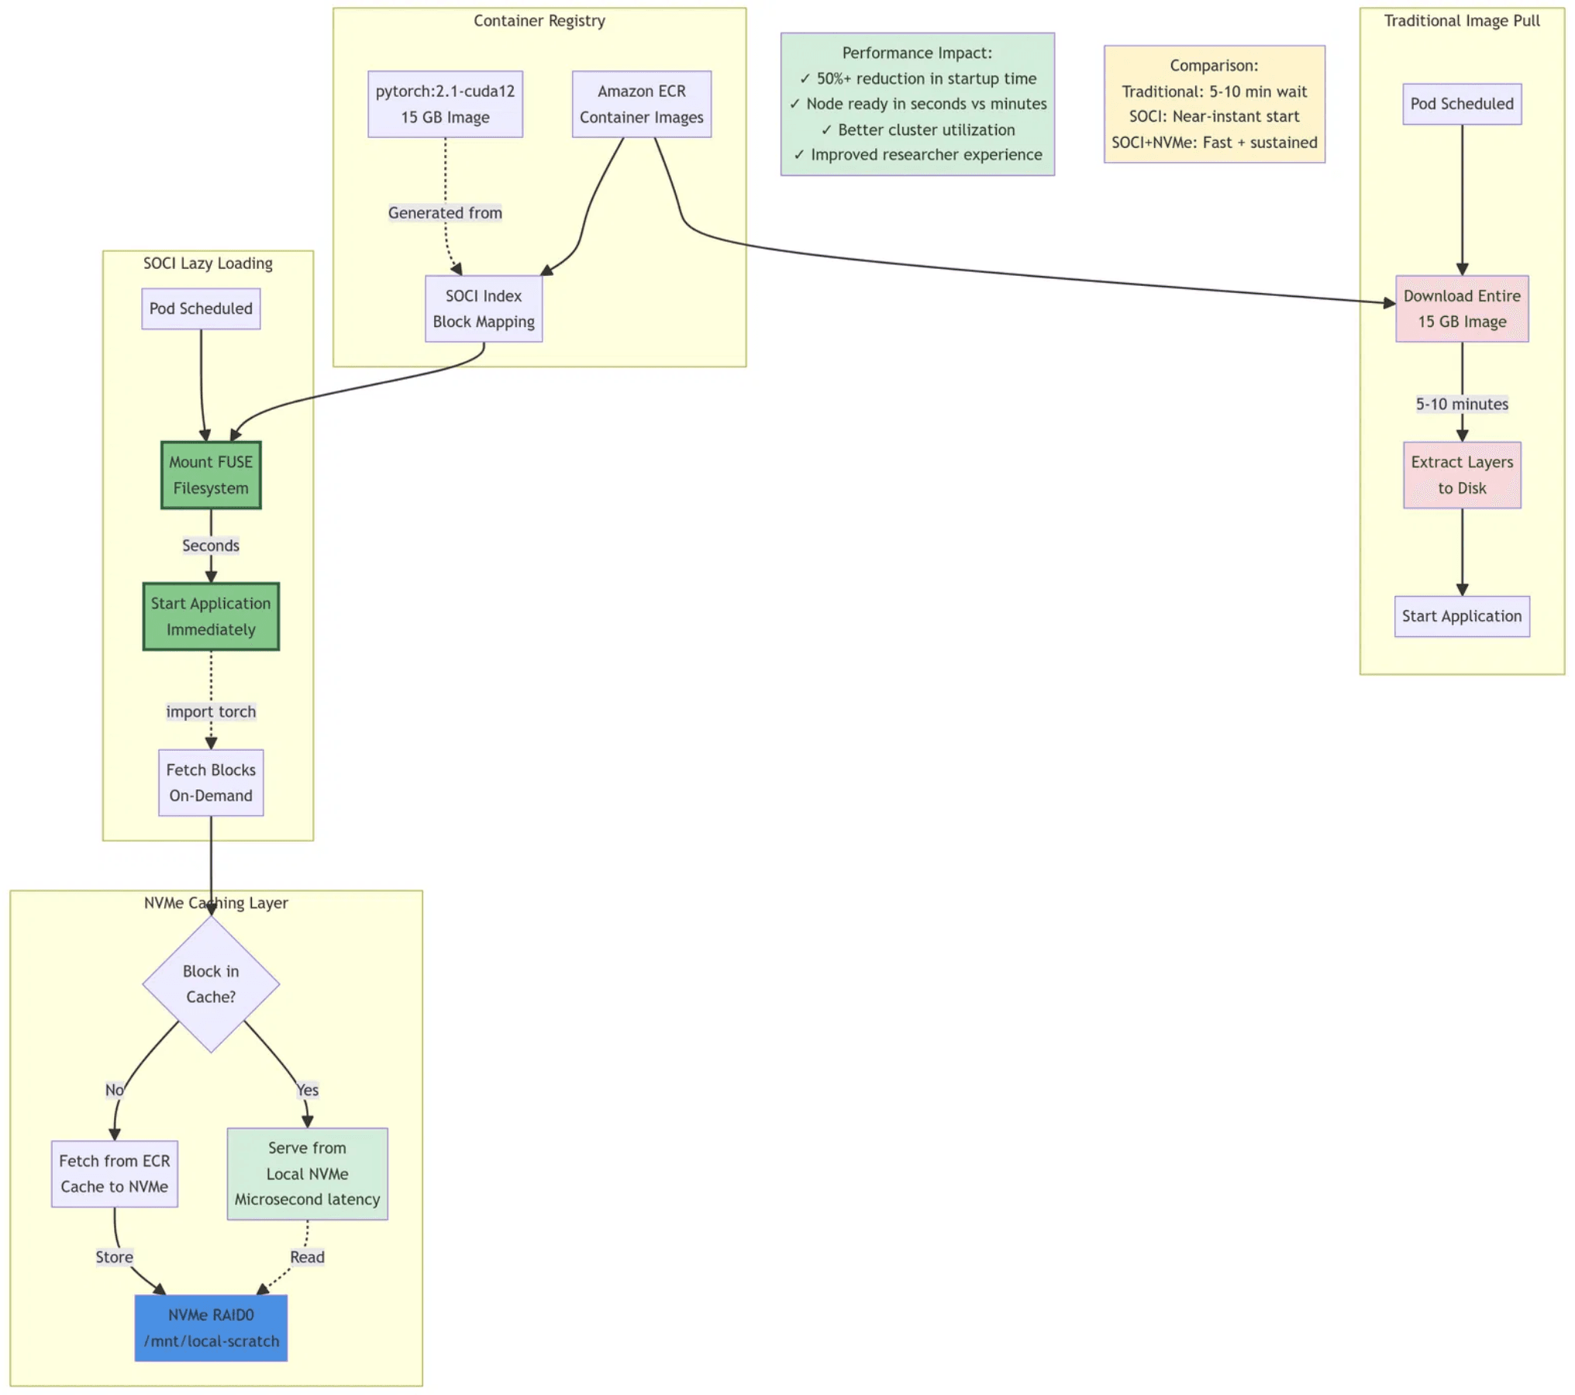
Image Vending: SOCI Lazy Loading
Eliminating the "Silent Killer" of Interactivity
The Problem
SOCI Loading Mechanism
Pulling 15GB+ deep learning images takes 5-10 minutes, destroying the interactive feel of the platform.
The Solution
Lazy Loading:

Start application immediately; fetch blocks on demand.
NVMe Caching:

Cache fetched blocks locally to mitigate FUSE overhead.
50%+
Reduction in Startup Latency
High-Performance Compute-as-a-Service
Slide 9

Slide 10


Failure Handling: Spot Recovery
Graceful Interruption Handling with SIGTERM and MOUNT_CACHED
The Critical Gap
Interruption Recovery Flow
Default ML scripts ignore SIGTERM. When the 2-minute spot warning expires, SIGKILL destroys all progress since the last checkpoint.
The Solution
Catch SIGTERM and trigger an emergency checkpoint to local NVMe.
defgraceful_exit(signum, frame): save_checkpoint() # Write to NVMe sys.exit(0) # Retry-able event signal.signal(signal.SIGTERM, graceful_exit)
MOUNT_CACHED Advantage
Writes to local disk at GB/s immediately. Uploads to S3 asynchronously. Reduces "checkpoint tax" by 10x.
High-Performance Compute-as-a-Service
Slide 10

Slide 11

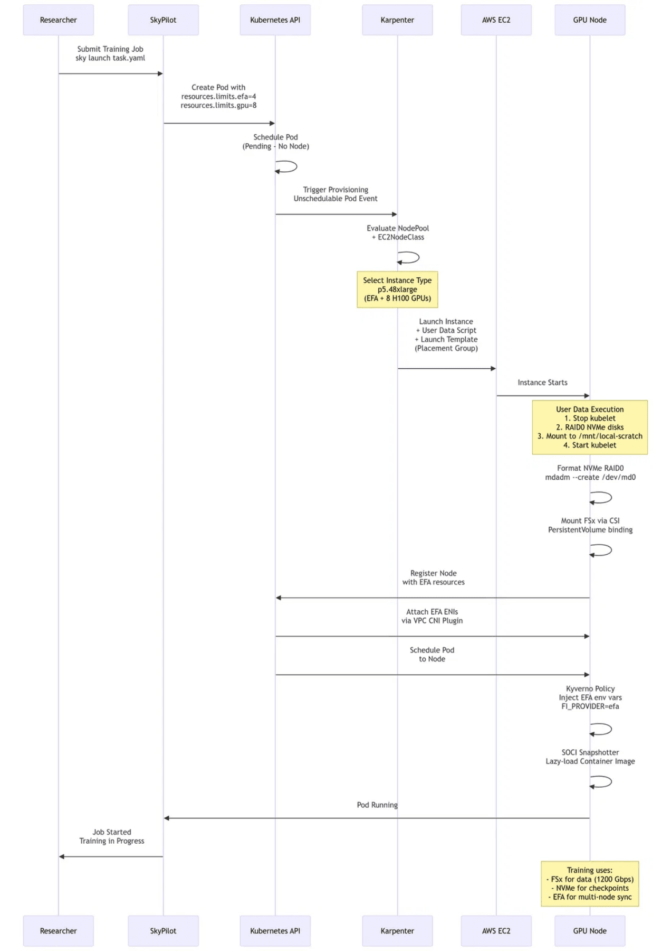
Karpenter Provisioning
Automated Node Configuration via User Data
Job Submission:
counter(step-counter)
SkyPilot requests 8 GPUs + EFA.
Provisioning Sequence
Evaluation:
counter(step-counter)
Karpenter selects p5.48xlarge instance.
Launch:
counter(step-counter)
Instance boots with User Data script.
Attachment:
counter(step-counter)
FSx mounted, EFA ENIs attached.
Critical Automation: NVMe RAID0
# NVMe RAID0 and kubelet restartsystemctl stop kubelet devices=$(lsblk -dno NAME | grep nvme...) mdadm --create /dev/md0 --level=0 ... mount /dev/md0 /mnt/local-scratch systemctl start kubelet
High-Performance Compute-as-a-Service
Slide 11

Slide 12


Decision Matrix
Ranked Architectural Choices for Researcher Experience
Guiding Principle
Architectural Decision Matrix
"Default configurations favor operational simplicity. We invert this to maximize Researcher Experience."
Ranking Methodology
Critical
Prevents job failures or major bottlenecks (Storage)
High
Significantly improves performance (Network, Images)
Medium
Reduces debugging time or cost (Logs, Spot)
Implementing these patterns transforms the platform from a simple job scheduler into a true high-performance research accelerator.
High-Performance Compute-as-a-Service
Slide 12

